Slide 1
Digital Signatures
The Electronic fingerprints

Slide 2

A digital signature is a PKI(public key infrastructure)-based digital certificate that authenticates the identity of the signer and ensures that electronically transmitted documents and digital messages have not been forged or tampered with.
Digital signatures can provide evidence of origin, identity and status of an electronic document, transaction or message and can acknowledge informed consent by the signer.
Why would you use a digital signature? Digital signatures increase the transparency of online interactions and develop trust between customers, business partners, and vendors.

Slide 3
How does it work ?
At the heart of it, a digital signature is the confirmation of the signer’s identity. It ensures that the electronic document has been signed by the person they claim to be and that there hasn’t been any tampering within the document post-creation.
Think of it this way: your signature is a locked box that requires two keys to open. If the keys don’t match, an alarm will go off, red lights will start flashing, the doors will shut close and everything collapses.
Of course that’s not going to happen but if the keys don’t match, the document will be invalidated and all of the parties will be notified.

Slide 4
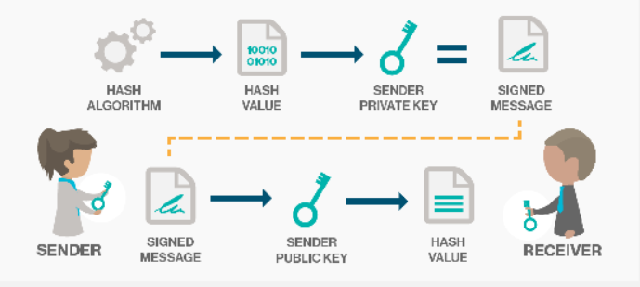
Behind the scenes

Slide 5
Each person adopting this scheme has a public-private key pair.
Generally, the key pairs used for encryption/decryption and signing/verifying are different. The private key used for signing is referred to as the signature key and the public key is referred as the verification key.
Signer gives data to the hash function.
Hash value and signature key are then given to the signature algorithm which produces the digital signature on the given hash. Signature is appended to the data and then both are sent to the verifier.
Verifier feeds the digital signature and the verification key into the verification algorithm. The verification algorithm gives some value as output.
Verifier also runs same hash function on received data to generate hash value.

Slide 6
For verification, this hash value and output of verification algorithm are compared. Based on the comparison result, verifier decides whether the digital signature is valid.
Since digital signature is created by ‘private’ key of signer and no one else can have this key; the signer cannot repudiate signing the data in future.
It should be noticed that instead of signing data directly by signing algorithm, usually a hash of data is created.

Slide 7
Importance
Message authentication : when the verifier validates the digital signature using public key of a sender, he is assured that signature has been created only by sender who possess the corresponding secret private key and no one else.
Data Integrity : in case an attacker has access to the data and modifies it, the digital signature verification at receiver end fails. The hash of modified data and the output provided by the verification algorithm will not match. So, receiver can safely deny the message assuming that data integrity has been breached.
Non-repudiation : since it is assumed that only the signer has the knowledge of the signature key, he can only create unique signature on a given data. Thus the receiver can present data and the digital signature to a third party as evidence if any dispute arises in the future.

Slide 8
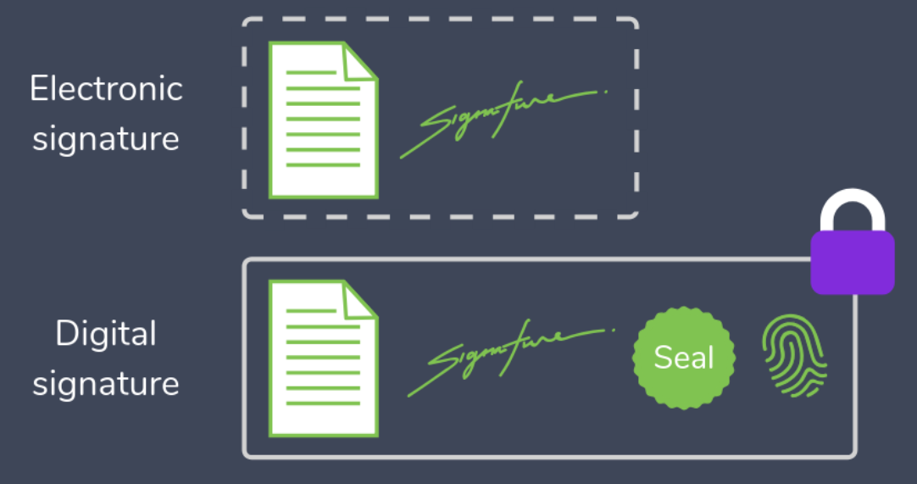
Electronic signatures vs digital signatures
Electronic signature and digital signature are often used interchangeably but the truth is that these two concepts are pretty different.

Slide 9
Digital signatures | Electronic signatures
Used to secure a document. | Used to verify a document.
Authorized and regulated by certification authorities. | Not authorized.
Comprised of more security features. | Comprised of less security features.
Common types of digital signature are based on Adobe and Microsoft. | Main types of electronic signature include verbal, electronic ticks or scanned signatures.
Can be verified. | Cannot be verified.
High levels of authenticity. | Easy to use but less authentic.

Slide 10
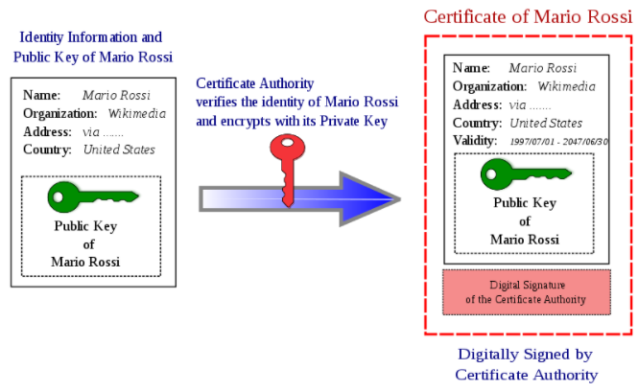
Certified authorities(ca)
A digital signature is verifiable since it is authorized by a trusted third party known as certification authority.
A certificate authority, also known as a certification authority issues digital signatures and act as a trusted third party by accepting, authenticating, issuing and maintaining digital certificates. The use of CAs helps avoid the creation of fake digital certificates

Slide 11
demo time

